Slide 1


Slide 2

Windows Academic Program
Supporting OS Teaching And Research
Dave Probert

Slide 3

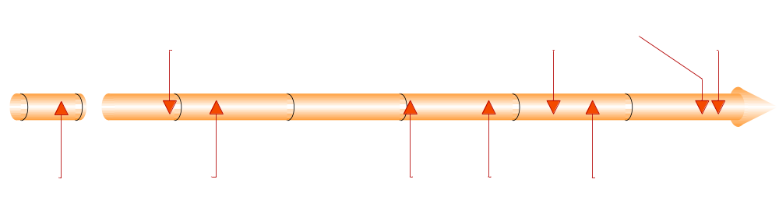
Shared Source History
WAP
Selective Sharing
Public Sharing
Collaborative Sharing
Windows Academic Program

Slide 4
Windows Academic Program Components
Windows Operating System Internals Curriculum Resource Kit (CRK) –
Presentation slides, experiments, labs, quizzes and assignments for introducing case studies from the Windows kernel
into operating
system courses
Windows Research Kernel –
The core kernel sources
and binaries integrated
with an environment
for building and testing
experimental
versions of the
Windows kernel
for use in teaching
and research
R E S E A R C H
I N S T R U C T I O N
CRK
WRK
ProjectOZ
ProjectOZ – An operating systems project environment that uses the native kernel interfaces of Windows to provide
simple, clean, user-mode abstractions of the CPU, MMU, trap mechanism,
and physical memory that can be used to perform experiments in operating systems principles

Slide 5
CRK (Curriculum Resource Kit)
Covers all ACM/IEEE/AIS OS BOK units and more
(based on Windows XP/Server 2003)
Scalable to multiple levels
Modular (can be used in whole/in part)
Case studies/compare and contrast
Basic modules provide materials to incorporate into a complete
basic level OS course of one semester in length; The modules
cover the Windows OS specific topics in the core and elective
units of the OS BOK of Computing Curricula 2001
Advanced modules provide materials to incorporate into an advanced level OS course of one semester in length; The modules cover the Windows OS specific topics in the core and elective units of the “CC2001” OS BOK as well as in three supplementary units
Contains references to source code
Notes:
© 2004 Microsoft Corporation. All rights reserved.
This presentation is for informational purposes only. Microsoft makes no warranties, express or implied, in this summary.

Slide 6
CRK Units
a. Core topics
  OS1. Overview of operating systms
  OS2. Operating system principles
  OS3. Concurrency
  OS4. Scheduling and dispatch
  OS5. Memory management
b. Elective topics
  OS6. Device management
  OS7. Security and protection
  OS8. File systems
  OS9. Real-time and embedded systems
  OS10. Fault tolerance
  OS11. System perf evaluation & troubleshooting
  OS12. Scripting
c. Supplementary topics
OS-A. Windows networking
OS-B. Comparing the Linux and Windows Kernels
OS-C. Windows – Unix Interoperability
Labs and Exercises, plus refs to WRK sources
Available now@http://www.msdnaa.net/curriculum
Notes:
© 2004 Microsoft Corporation. All rights reserved.
This presentation is for informational purposes only. Microsoft makes no warranties, express or implied, in this summary.

Slide 7
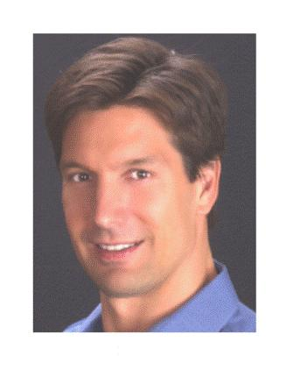
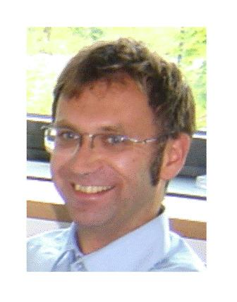
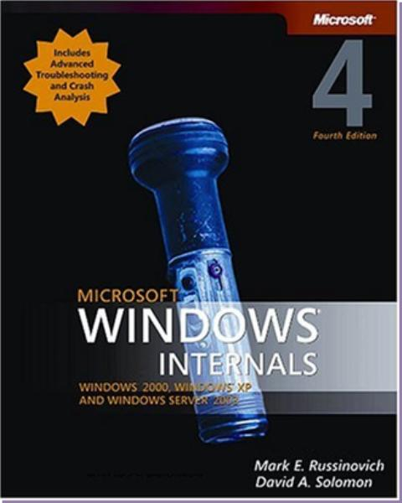
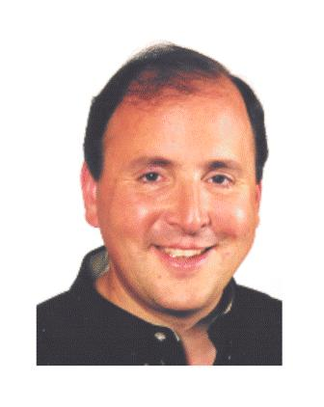
CRK Authors
Industry
Academia
Mark Russinovich is chief software architect and cofounder of Winternals Software (www.winternals.com), a company that specializes in advanced systems software for Microsoft Windows. Mark is co-author of Inside Windows 2000, 3rd Edition (Microsoft Press) with David Solomon andsuccessor, Windows Internals, 4th Edition (Microsoft Press).
Mark is a Microsoft Most Valuable Professional (MVP) and serves as senior contributing editor for Windows IT Pro magazine where he contributes to the Windows Power Tools column. He is also a frequent speaker at major industry conferences such as Microsoft Tech Ed, IT Forum, Windows IT Pro Magazine's Connections and Redmond Magazine's TechMentor.
Mark has a B.S. from Carnegie Mellon University and a M.S. from Rensselaer Polytechnic Institute, both in computer engineering. In 1994, he earned a Ph.D. from Carnegie Mellon University, also in computer engineering.
Andreas Polze is the Operating Systems and Middleware Professor at the Hasso-Plattner-Institute for Software Engineering at University Potsdam, Germany. He received a doctoral degree from Freie University Berlin, Germany, in 1994 and a habilitation degree from Humboldt University Berlin in 2001, both in computer science. His habilitation thesis investigates Predictable Computing in Multicomputer-Systems. Current research interests include Interconnecting Middleware and Embedded Systems, Mobility and Adaptive System Configuration, and End-to-End Service Availability for standard middleware platforms.
At University Potsdam, his current teaching activities focus on architecture of operating systems, on component-based middleware, as well as on predictable distributed computing. Our curriculum includes lectures that discuss operating system issues based on standard platforms (Windows 2000/XP, Mac OS X (BSD Unix), and Solaris) as well as on embedded systems (Windows CE, Embedded Linux).
Prof. Polze was a visiting scientist with the Dynamic Systems Unit at Software Engineering Institute, at Carnegie Mellon University, Pittsburgh, USA, were he worked on real-time computing on standard middleware (CORBA), and with the Real-Time Systems Laboratory at University of Illinois, Urbana-Champaign.
David Solomon (www.solsem.com) teaches classes on Windows kernel internals to developers and IT professionals at companies worldwide, including Microsoft. He is the co-author of Windows Internals, 4th edition, the official Microsoft Press book on Windows kernel internals, as well as the previous edition, Inside Windows 2000. David also wrote Inside Windows NT, 2nd edition, and Windows NT for OpenVMS Professionals. He also co-created the Windows Internals COMPLETE video series which Microsoft licensed for worldwide internal training. David has served as technical chair for three past Windows NT conferences and has spoken at many TechEds and PDCs. He was a recipient of the 1993 & 2005 Microsoft Support Most Valuable Professional (MVP) award.

Slide 8

WRK (Windows Research Kernel)
Source from the latest shipping Windows (NTOS) kernel
Version – Windows Server 2003 (x86/x64) and Windows XP x64
Included sources – most everything in NTOS – processes, threads, LPC, VM, scheduler, object manager, I/O manager, synchronization, worker threads, kernel memory manager, …
Excluded sources – plug-and-play, power-management, and specialized code such as the driver verifier, splash screen,
branding, timebomb, etc.
Build environment – makefile-based with object library for
the excluded sources; Kernels boot on native hardware or
using VirtualPC
Notes:
© 2004 Microsoft Corporation. All rights reserved.
This presentation is for informational purposes only. Microsoft makes no warranties, express or implied, in this summary.

Slide 9
WRK Goals
Simplified licensing to allow classroom
and lab use
Make it easier for faculty and students
to compare and contrast Windows to
other operating systems
Enable students to study source, and
modify and build projects
Provide better support for research and publications based on Windows internals
Encourage more OS textbook and university-oriented internals books on Windows kernel
Notes:
© 2004 Microsoft Corporation. All rights reserved.
This presentation is for informational purposes only. Microsoft makes no warranties, express or implied, in this summary.

Slide 10
WRK Licensing
Goals
  Faculty feel comfortable agreeing to its conditions
  Students can use in classroom/lab environment
License type
  Non-commercial, academic use only; allows
  derivative works for non-commercial purpose
Eligibility criteria
  Available to faculty and students in colleges/universities WW
Usage scenarios
  View, copy, reproduce, distribute within the institution
  Modify for teaching and experimentation purposes
  Produce teaching and research publications including
  relevant snippets of source
    Can use in textbooks and academic publications, and community forums
    Have to perpetuate Microsoft copyright notices
  Share derivatives within academic community
Notes:
© 2004 Microsoft Corporation. All rights reserved.
This presentation is for informational purposes only. Microsoft makes no warranties, express or implied, in this summary.

Slide 11
ProjectOZ Experimental Environment For OS Projects
An OS project environment using NTAPI
Provides simple, user-mode abstractions
  CPU, MMU, trap mechanism, and physical memory
Supports experiments in OS principles
Use real OS features rather than a ‘toy’ simulation
Reduce complexity required to learn/build experiments
A simple development environment, using standard
tools for building, debugging, and instrumentation
Encourage ‘out-of-the-box’ thinking by students
Based on SPACE project at UCSB (Probert and Bruno)
Notes:
© 2004 Microsoft Corporation. All rights reserved.
This presentation is for informational purposes only. Microsoft makes no warranties, express or implied, in this summary.

Slide 12
ProjectOZ
Workloads, tests,
instrumentation
workloads
Student projects
and experiments
ProjectOZ
Initial OS implementation
Small amount of code
Students inspired to do better
BasicOZ
SPACE abstractions of CPU, MMU, Traps
SPACE.exe
NT native API
NT Kernel
ProjectOZ runs in user-mode on a standard Windows system
Windows

Slide 13
BasicOZ
A very simple OS implementation
  Familiar functionality (processes, threads,
  user/kernel, virtual memory, devices, namespaces)
  Minimal implementations using simple algorithms
  and providing limited functionality
  Small amount of code (~2-3 kloc)
  Based on SPACE primitives built on NTAPI
Goals
  Students have limited code to read/modify
  Underlying abstractions are clean and simple
  BasicOZ seems too rudimentary – inspiring students
Notes:
© 2004 Microsoft Corporation. All rights reserved.
This presentation is for informational purposes only. Microsoft makes no warranties, express or implied, in this summary.

Slide 14
Windows Research Kernel

Slide 15
NT Timeline First 17 Years
2/1989 Coding Begins
7/1993 NT 3.1
9/1994 NT 3.5
5/1995 NT 3.51
7/1996 NT 4.0
12/1999 NT 5.0 Windows 2000
8/2001 NT 5.1 Windows XP
3/2003 NT 5.2 Server 2003
8/2004 NT 5.2 Windows XP SP2
4/2005 NT 5.2 Windows XP 64 Bit Edition (and WS03SP1)
2006 NT 6.0 Windows Vista (client)
WRK

Slide 16
Windows Architecture
Applications
Subsystem
servers
DLLs
System Services
Login/GINA
Kernel32
Critical services
User32/GDI
User-mode
ntdll/run-time library
Kernel-mode
Trap interface / LPC
Security refmon
I/O Manager
Virtual memory
Procs and threads
Win32 GUI
Net devices
File filters
Filesys run-time
Scheduler
Net protocols
File systems
Net Interfaces
Volume mgrs
Cache mgr
Synchronization
Device stacks
Object Manager/Configuration Management (registry)
Kernel run-time/Hardware Adaptation Layer

Slide 17
Important NT Kernel Features
Highly multi-threaded
Completely asynchronous I/O model
Thread-based scheduling
Object-manager provides unified management of
  Kernel data structures
  Kernel references
  User references (handles)
  Namespace
  Synchronization objects
  Resource charging
  Cross-process sharing
Centralized ACL-based security reference monitor
Configuration store decoupled from file system

Slide 18
Important NT Kernel Features
Extensible filter-based I/O model with driver layering, standard device models, notifications, tracing, journaling, namespace, services/subsystems
Virtual address space managed separately
from memory objects
Advanced VM features for databases (app management of virtual addresses, physical memory, I/O, dirty bits, and large pages)
Plug-and-play, power-management
System library mapped in every process provides trusted entry points

Slide 19
NT Kernel Design Workbook
NT OS/2 Design Workbook: Core OS
File | Title | Author(s)
dwintro | NT OS/2 Design Workbook Introduction | Lou Perazzoli
ke | NT OS/2 Kernel Specification | David N. Cutler, Bryan M. Willman
alerts | NT OS/2 Alerts Design Note | David N. Cutler
apc | NT OS/2 APC Design Note | David N. Cutler
ob | NT OS/2 Object Management Specification | Steven R. Wood
proc | NT OS/2 Process Structure | Mark Lucovsky
suspend | NT OS/2 Suspend/Resume Design Note | David N. Cutler
attproc | NT OS/2 Attach Process Design Note | David N. Cutler
vm | NT OS/2 Virtual Memory Specification | Lou Perazzoli
vmdesign | NT OS/2 Memory Management Design Note | Lou Perazzoli
io | NT OS/2 I/O System Specification | Darryl E. Havens
irp | NT OS/2 IRP Language Definition | Gary D. Kimura
namepipe | NT OS/2 Named Pipe Specification | David Cutler & Gary Kimura
mailslot | NT OS/2 Mailslot Specification | Manny Weiser
rsm | Windows NT Session Management and Control | Mark Lucovsky
fsdesign | NT OS/2 File System Design Note | Gary D. Kimura
fsrtl | NT OS/2 File System Support Routines Specification | Gary D. Kimura

Slide 20
NT Kernel Design Workbook
NT OS/2 Design Workbook: Core OS
File | Title | Author(s)
sem | NT OS/2 Event – Semaphore Specification | Lou Perazzoli
argument | NT OS/2 Argument Validation Specification | David N. Cutler
timer | NT OS/2 Timer Specification | David N. Cutler
coding | NT OS/2 Coding Conventions | Mark Lucovsky, Helen Custer
ulibcode | NT Utilities Coding Conventions | David J. Gilman
exceptn | NT OS/2 Exception Handling Specification | David N. Cutler
os2 | OS/2 Emulation Subsystem Specification | Steven R. Wood
status | NT OS/2 Status Code Specification | Darryl E. Havens
ntdesrtl | NT OS/2 Subsystem Design Rational | Mark H. Lucovsky
resource | NT OS/2 Shared Resource Specification | Gary D. Kimura
execsupp | NT OS/2 Executive Support Routines Specification | David Treadwell
support | NT OS/2 Interlocked Support Routines Specification | David N. Cutler
dd | Windows NT Driver Model Specification | Darryl E. Havens
oplock | NT OS/2 Opportunistic Locking Design Note | Darryl Havens, et al
memio | NT OS/2 Memory Management Guide for I/O | Lou Perazzoli
time | NT OS/2 Time Conversion Specification | Gary D. Kimura
mutant | NT OS/2 Mutant Specification | David N. Cutler

Slide 21
NT Kernel Design Workbook
NT OS/2 Design Workbook: Core OS
File | Title | Author(s)
prefix | NT OS/2 Prefix Table Specification | Gary D. Kimura
startup | NT OS/2 System Startup Design Note | Mark Lucovsky
dbg | NT OS/2 Debug Architecture | Mark Lucovsky
coff | NT OS/2 Linker/Librarian/Image Format Spec | Michael J. O'Leary
cache | NT OS/2 Caching Design Note | Tom Miller
ntutil | NT OS/2 Utility Design Specification | Steven D. Rowe
implan | NT OS/2 Product Description and Implementation Plan | David N. Cutler
basecont | NT OS Base Product Contents | Lou Perazzoli

Slide 22
WRK Organization
arb | Plug-and-play arbiter | lpc | Local inter-process calls
cache | Cache Manager | mm | Memory Manager
config | Registry | nls | Internationalization code
dbgk | User-mode debugging | ob | Object Manager
ex | Executive functions | perf | Performance Tracing
fsrtl | File system run-time | po | Power Management
fstub | File sys boot interface | ps | Process/thread
inc | Kernel-specific includes | raw | Raw volume driver
init | Boot code | rtl | Kernel run-time library
io\iomgr | I/O manager | se | Security Ref Monitor
io\pnpmgr | Plug-and-play manager | vdm | Virtual Dos Machine
kd64 | Kernel debug interface | verifier | Driver Verifier
ke | Kernel (scheduler, etc) | wmi | Windows Mgmt Interface

Slide 23
Building The WRK
See README.txt
path %wrk%\tools\x86;%path%
cd %wrk%\base\ntos
nmake x86=
Edit \boot.ini file of system or VirtualPC
  add entry specifying kernel and hal

Slide 24
WRK Organization
doxygen callgraphs For The WRK
Prof. Dr. Andreas Polze polze@hpi.uni-potsdam.de
Hasso-Plattner-Institute www.dcl.hpi.uni-potsdam.de
for Software Systems Engineering www.polze.de/andreas
Operating Systems and Middleware Chair

Slide 25
Compare And Contrast
OS design environments
 | UNIX (1970s) | NT (1980/1990s) | ?? (2000/2010s)
Address space | 16b, swapping | 32-bit, linear VM | 64-bit, ??
CPU perf | KIPS | MIPS | GIPS
Synchr | IRQL | Test&Set, Cmpr&Swap | Transactional memory?
Memory size | KBytes | MBytes | GBytes
Hard concurrency | none | SMP | High-Multicore
Mass storage | Kbytes, slow seek | Mbytes, slow seeks | GBytes, no seeks TBytes
Distrib. computing | Tape | Client/server | Peer-to-peer
Old OS designs can (of course) be ported, but
How you would design an OS on blank paper?
How should the CPU system architecture evolve?

Slide 26
Compare And Contrast
Key NTOS Design Decisions
Thread is unit of concurrency
Unified synchronization and naming mechanisms
Namespace not rooted in file system
Separated Virtual Address and
Memory Object management
Asychronous, extensible I/O model (filtering)
ACL-based security, token-based identity
Integrated configuration-store
System library mapped into every process

Slide 27
Operating Systems Of The Future?
Security architecture, mechanisms, and tools
Application models for state mgmt and system extensibility
Code analysis using tools like the Phoenix compiler
Integration of managed and non-managed technologies
Implementation of simpler kernel abstractions
Object-based kernel services
User-mode ‘kernel’ services (drivers, extensions)
Version and upgrade management for platform and apps
Management of complexity
Federation of distributed computing and storage devices

Slide 28
Summary And Contact Information
CRK
Core, Elective and Supplementary units available for free download
ProjectOZ and WRK
Available for download
Feedback
Contact us at compsci@microsoft.com
More information on WAP and related topics
Shared Source Web Site http://www.microsoft.com/resources/sharedsource/Licensing/WindowsAcademic.mspx
Forums for discussion and access to Windows kernel and arch team http://forums.microsoft.com/WindowsAcademic
Curriculum Repository on MSDNAA http://www.msdnaa.net/curriculum/pfv.aspx?ID=6191
Notes:
© 2004 Microsoft Corporation. All rights reserved.
This presentation is for informational purposes only. Microsoft makes no warranties, express or implied, in this summary.

Slide 29

© 2006 Microsoft Corporation. All rights reserved.
Microsoft, Windows, Windows Vista and other product names are or may be registered trademarks and/or trademarks in the U.S. and/or other countries.
The information herein is for informational purposes only and represents the current view of Microsoft Corporation as of the date of this presentation.
Because Microsoft must respond to changing market conditions, it should not be interpreted to be a commitment on the part of Microsoft,
and Microsoft cannot guarantee the accuracy of any information provided after the date of this presentation.
MICROSOFT MAKES NO WARRANTIES, EXPRESS, IMPLIED OR STATUTORY, AS TO THE INFORMATION IN THIS PRESENTATION.

